Slide 1
Ontology-Based Modelling of AI Fundamental Rights Impacts(FRIA): Integrating Impact Assessment based on VAIR, AIRO, CIDS and LLMs
Supervisor: Dr. David Lewis Dr. Subrahmanyam Murala
Kaiyu Chen (23330889)
MSc in Computer Science - Intelligent Systems

Slide 2
Quote Slide Option 1
[0] Mantelero, Alessandro and Esposito, Samantha, An Evidence-Based Methodology for Human Rights Impact Assessment (HRIA) in the Development of AI Data-Intensive Systems (March 22, 2021). Computer Law & Security Review, 2021, Available at SSRN: https://ssrn.com/abstract=3829759
[1] https://public-buyers-community.ec.europa.eu/communities/procurement-ai/news/new-version-procurement-clauses-ai-available-supporting-responsible
[2] Delaram Golpayegani, Harshvardhan J. Pandit, and Dave Lewis. 2023. To Be High-Risk, or Not To Be—Semantic Specifications and Implications of the AI Act’s High-Risk AI Applications and Harmonised Standards. In Proceedings of the 2023 ACM Conference on Fairness, Accountability, and Transparency (FAccT '23). Association for Computing Machinery, New York, NY, USA, 905–915. https://doi.org/10.1145/3593013.3594050
[3] https://www.aiaaic.org/aiaaic-repository
Despite the early stage of AI impact prediction ^{[0]}, the EU‘s proposed AI Act may require impact assessments for new AI projects^{[1]}, focusing on fundamental rights and other key areas. This project aims to explore how to make semantic models become a help for AI risk assessment ^{[2]} and how it can be applied to publicly available AI incident reports from AIAAIC^{[3]} to support compliance and oversight under the AI Act.

Slide 3
Quote Slide Option 1
Ontologies provide a formal representation of knowledge and the relationships between concepts of a domain. They are used in the requirements specification to guide formal and unambiguous specification of the requirements, particularly in expressing concepts, relations and business rules of domain model with varying degrees of formalization and precision^{[4][5]}
[4] Emebo, Onyeka & Varde, Aparna & Daramola, Olawande. (2021). Common Sense Knowledge, Ontology and Text Mining for Implicit Requirements.
[5] Sugumaran, V., & Storey, V. C. (2002). Ontologies for conceptual modeling: their creation, use, and management. Data & knowledge engineering, 42(3), 251-271.

Slide 4
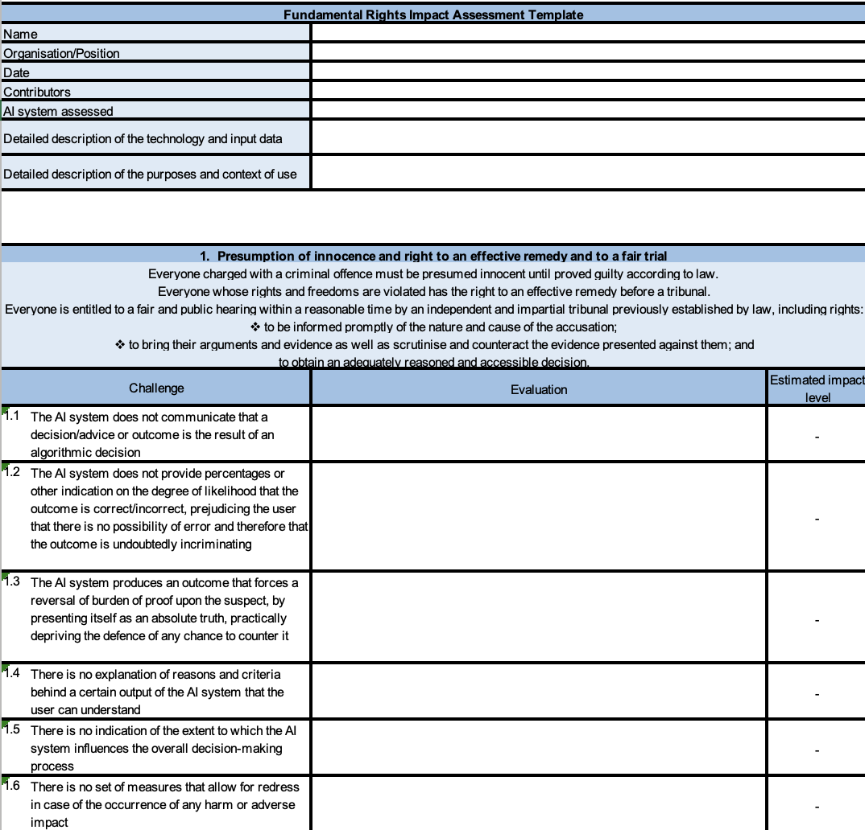
Fundamental Rights Impact Assessment (FRIA)^{[6]}
Artificial intelligence can incredibly enhance law enforcement agencies’ capabilities to prevent, investigate, detect and prosecute crimes, as well as to predict and anticipate them. However, despite the numerous promised benefits, the use of AI systems in the law enforcement domain raises numerous ethical and legal concerns.
The ALIGNER Fundamental Rights Impact Assessment (AFRIA) is a tool addressed to LEAs who aim to deploy AI systems for law enforcement purposes within the EU. The AFRIA is a reflective exercise, seeking to further enhance LEAs’ already existing legal and ethical governance systems, by assisting them in building and demonstrating compliance with ethical principles and fundamental rights while deploying AI systems.
^{[6]}https://aligner-h2020.eu/fundamental-rights-impact-assessment-fria/
Notes:
FRIA is a project which received funding from the European Union’s Horizon 2020 research and innovation programme under Grant Agreement no. 101020574. It’s is a tool addressed to LEAs who aim to deploy AI systems for law enforcement purposes within the EU. It connects to the EU AI Act by providing a practical tool for law enforcement to assess AI‘s impact on fundamental rights. It helps agencies comply with potential AI Act requirements, especially around impact assessments. AFRIA guides users to identify risks and plan mitigations, aligning with the EU’s goals for responsible AI use in sensitive areas like law enforcement. Since the ontology is a good tool to describe something both for human and machine, why we can’t combine this two things together?

Slide 5
Quote Slide Option 1
AI Risk Ontology (AIRO)^{[7]}
AIRO is an ontology for expressing risk of harm associated with AI systems based on the EU AI Act and ISO/IEC 23894 on AI risk management.
Vocabulary of AI Risks (VAIR) ^{[8]}
VAIR is an open vocabulary for AI risks. VAIR is intended to assist with identification and documentation of risks by providing a common vocabulary that facilitates knowledge sharing and interoperability between actors in the AI value chain. VAIR provides semantic specifications for cataloguing AI risks in a FAIR (Findable, Accessible, Interoperable, Reusable) manner.
Common Impact Data Standard(CIDS) ^{[9]}
The Common Impact Data Standard is a standardized way to represent a social purpose organization’s (SPO) impact model (i.e. their theory of change, logic model, outcome chain, etc). It is a way to represent impact as defined by the Impact Management Project Norms (now housed at Impact Frontiers). It enables the exchange of impact information between organizations regardless of the impact models being used.
^{[7]} https://w3id.org/airo
^{[8]} https://w3id.org/vair
^{[9]} https://www.commonapproach.org/common-impact-data-standard/
Notes:
AIRO, VAIR, and CIDS are frameworks designed to assess and manage risks and impacts of AI and other technologies, each with a different focus. While AIRO and VAIR specifically address AI risks, and CIDS provides a standardized approach to represent impact models, they can all complement FRIA by offering structured vocabularies and methodologies to enhance the assessment of AI's impact on fundamental rights.

Slide 6
Quote Slide Option 1
Research Questions
How can we integrate Fundamental Rights Impact Assessment (FRIA) into existing ontological frameworks such as AI Risk Ontology (AIRO), Vocabulary of AI Risks (VAIR), and Common Impact Data Standard (CIDS) to create a more comprehensive ontological structure for impact assessment?
To what extent can Large Language Models (LLMs) be effectively utilized to populate Fundamental Rights Impact Assessment (FRIA) reports and related ontologies, thereby assisting in the completion of AI impact assessments?

Slide 7



Quote Slide Option 2
Motivation
New technologies have profoundly changed how we organise and live our lives. In particular, new data-driven technologies have spurred the development of artificial intelligence (AI), including increased automation of tasks usually carried out by humans. The COVID-19 health crisis has boosted AI adoption and data sharing – creating new opportunities, but also challenges and threats to human and fundamental rights.^{[10]}
Artificial Intelligence (AI) impact assessments are crucial for evaluating the potential impact of AI systems on fundamental rights such as privacy, non-discrimination, and freedom of expression.
LLMs can extract and categorize information from vast amounts of text into structured data that can be integrated into ontologies, contributing to the creation of comprehensive and accurate knowledge graphs.
^{[10]} https://fra.europa.eu/en/publication/2020/artificial-intelligence-and-fundamental-rights
Notes:
Most 3 motivation:
1. The new AI technology has bring https://fra.europa.eu/en/publication/2020/artificial-intelligence-and-fundamental-rights.
2. We need impact assessments to protect our fundamental rights
3. LLM with ontology is useful and can make the result 1+1 > 2.

Slide 8
Quote Slide Option 1
Main Goal
Develop FIRA ontology
Find the relationship between FRIA and CIDS, AIRO, VAIR
Develop the relationship
Have some useful prompt for LLMs to generate the instances based on the designed ontology and given incidents
Evaluation
GraphDB show cases

Slide 9
Quote Slide Option 1
Main Goal
Research Question 1
Develop FIRA ontology
Find the relationship between FRIA and CIDS, AIRO, VAIR
Develop the relationship
Research Question 2
Have some useful prompt for LLMs to generate the instances based on the designed ontology and given incidents
Evaluation
GraphDB show cases

Slide 10

Why I did this?
Respond to the EU AI Act
Aligning with legal and regulatory requirements, promoting compliance and responsible AI development.
Sharing and reusing knowledge across domains, contributing to develop a basic farmwork for AI impact Assessment.
Advancing AI governance and ensuring AI systems respect fundamental rights and ethical principles.
Ensuring consistency and compatibility across various AI impact assessment frameworks. Make sure the information sharing and collaboration.
Developing a comprehensive and holistic approach to assessing AI system risks and impacts.
Trinity College Dublin, The University of Dublin

Slide 11
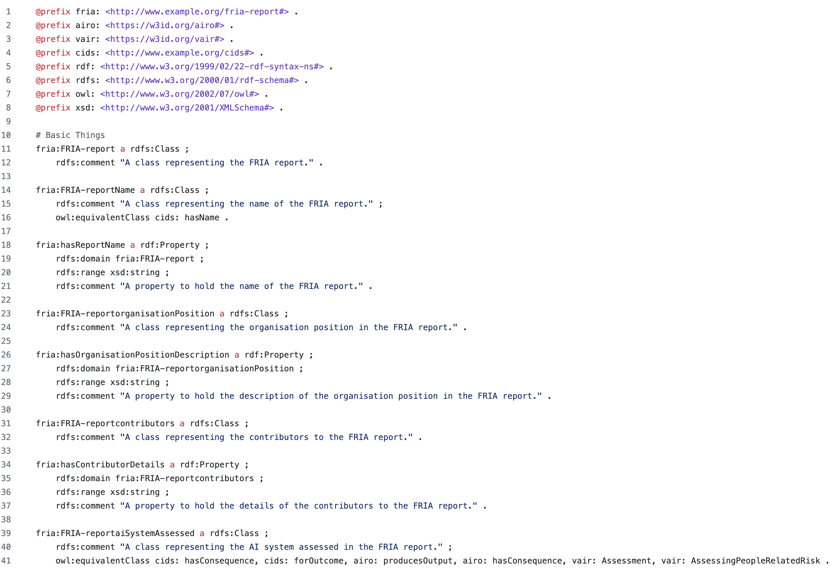
Design of the ontology

Slide 12
FRIA with CIDS, AIRO, VAIR
Basic Things
FRIA | CIDS | AIRO | VAIR
hasName | hasName
organisationPosition
date
contributors
aiSystemAssessed | hasConsequence | producesOutput | Assessment
 | forOutcome | hasConsequence | AssessingPeopleRelatedRisk
technologyAndData |  | usesTechnique
purposesAndContext | hasDescription | haspurpose | Purposes
12

Slide 13
FRIA with CIDS, AIRO, VAIR
Some of the Challenges Related Things
Challenge11
The AI system does not communicate that a decision/advice or outcome is the result of an algorithmic decision
VAIR
Transparency
Property of a system that appropriate information about the system is made available to relevant stakeholders
DecisionMaking
Generation of decisions

Slide 14
FRIA with CIDS, AIRO, VAIR
Challenge16
There is no set of measures that allow for redress in case of the occurrence of any harm or adverse impact
AIRO
hasRisk
Indicates risks associated with an AI system, an AI component, etc.
hasSeverity
Indicates severity of a consequence or an impact
CIDS
hasImportance
Specifies the nature of the importance. One of {“high importance”, “moderate important”, “neutral”, “unimportant”}.
intendedimpact
Identifies the intended direction of the change. Note that ImpactReport captures the actual direction. This helps to inform the interpretation of the ImpactReport.helps to inform the interpretation of the ImpactReport.
Some of the Challenges Related Things
Notes:
Challenge16 addresses the lack of redress measures for harm or adverse impacts. In AIRO, 'hasRisk' and 'hasSeverity' are directly relevant, as they can be used to identify and quantify the potential risks and impacts that might require redress. CIDS's 'hasImportance' and 'intendedimpact' concepts also align with Challenge16, as they help prioritize and contextualize the impacts, which is crucial when considering redress measures.

Slide 15
Quote Slide Option 1
Research Questions
How can we integrate Fundamental Rights Impact Assessment (FRIA) into existing ontological frameworks such as AI Risk Ontology (AIRO), Vocabulary of AI Risks (VAIR), and Common Impact Data Standard (CIDS) to create a more comprehensive ontological structure for impact assessment?
To what extent can Large Language Models (LLMs) be effectively utilized to populate Fundamental Rights Impact Assessment (FRIA) reports and related ontologies, thereby assisting in the completion of AI impact assessments?

Slide 16
Prompt
Now, when given an incident report, find the relevant information for each part of the RDF definition and fill in the Turtle format using the information found. So you need to return Turtle representation for the incident report. Always include all of the properties in the RDF output.
If there is no relevant information for a given property in the report, return a blank value in the RDF. However, if you can understand and fill in the blank value based on the available information, start the value with "LLM understand: ". For Basic Things like fria:hasAssessmentContent, if the provided information is too long, you then need to summarize appropriately based on the content. For the date, try to access the specific AIAAIC Link and retrieve the time information, if you can't access the provided link, try to find it based on provided information.
If there are some details you cannot find or understand, leave those properties blank.
For the Challenges, Evaluation, and Impact Level sections, follow the guidelines provided:
Review the FRIA template's pre-listed challenges, adding any system-specific ones. Evaluate each challenge's relevance to the AI system, explaining its embedding and impact within the law enforcement context. Assess the severity of prejudice and affected population to determine the overall impact level using the provided matrix. Consider the predetermined context of use, including target group, geographical area, deployment period, and trigger conditions. Provide detailed explanations for each evaluation and impact estimate. Regularly update the FRIA to reflect changes in the AI system's functioning or deployment circumstances.
When evaluating the impact level, follow the guidelines provided in the prompt:
Determine the severity of prejudice: Negligible, Critical, or Catastrophic.
Evaluate the number of affected individuals: Low, Medium, or High.
Use the impact matrix to determine the overall impact level: Low, Medium, High, or Very High.
Based on the instructions provided, you can only have 4 impact level! Decide inside 4 of them(Low, Medium, High, or Very High)!!
You need to return complete RDF/Turtle representation for the incident report, including all basic things, challenges, evaluations and impact levels for each challenge.
Do you understand? if so reply yes with no further follow up and await an incident report.

Slide 17
Claude 3.5 Sonnet
Claude 3.5 Sonnet raises the industry bar for intelligence, outperforming competitor models and Claude 3 Opus on a wide range of evaluations, with the speed and cost of our mid-tier model, Claude 3 Sonnet.
GPT-4o
GPT-4o (“o” for “omni”) is a step towards much more natural human-computer interaction—it accepts as input any combination of text, audio, image, and video and generates any combination of text, audio, and image outputs. It can respond to audio inputs in as little as 232 milliseconds, with an average of 320 milliseconds, which is similar to human response time(opens in a new window) in a conversation.

Slide 18
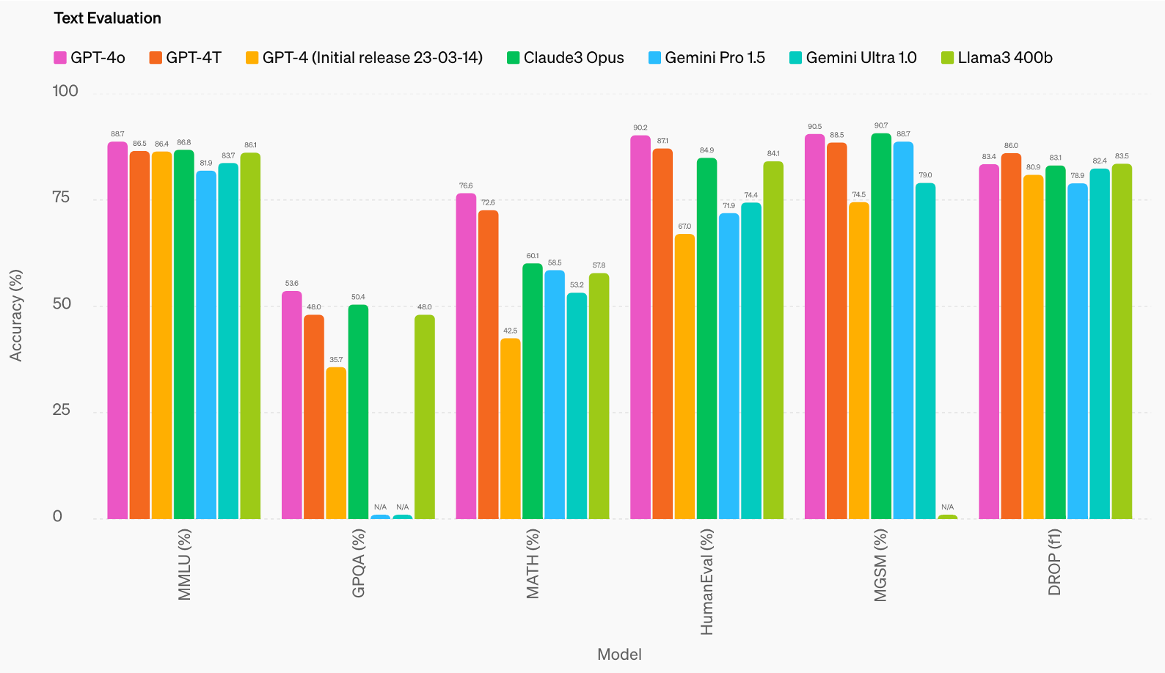
^{[11]}
^{[11]} https://openai.com/index/hello-gpt-4o/

Slide 19
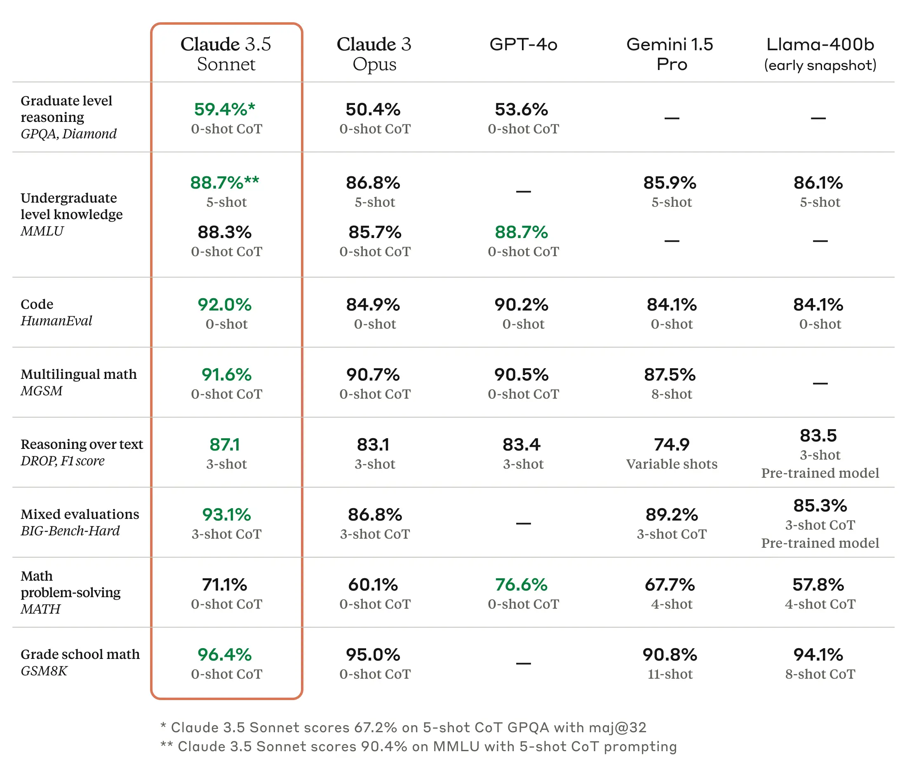
^{[12]}
^{[12]} https://www.anthropic.com/news/claude-3-5-sonnet

Slide 20
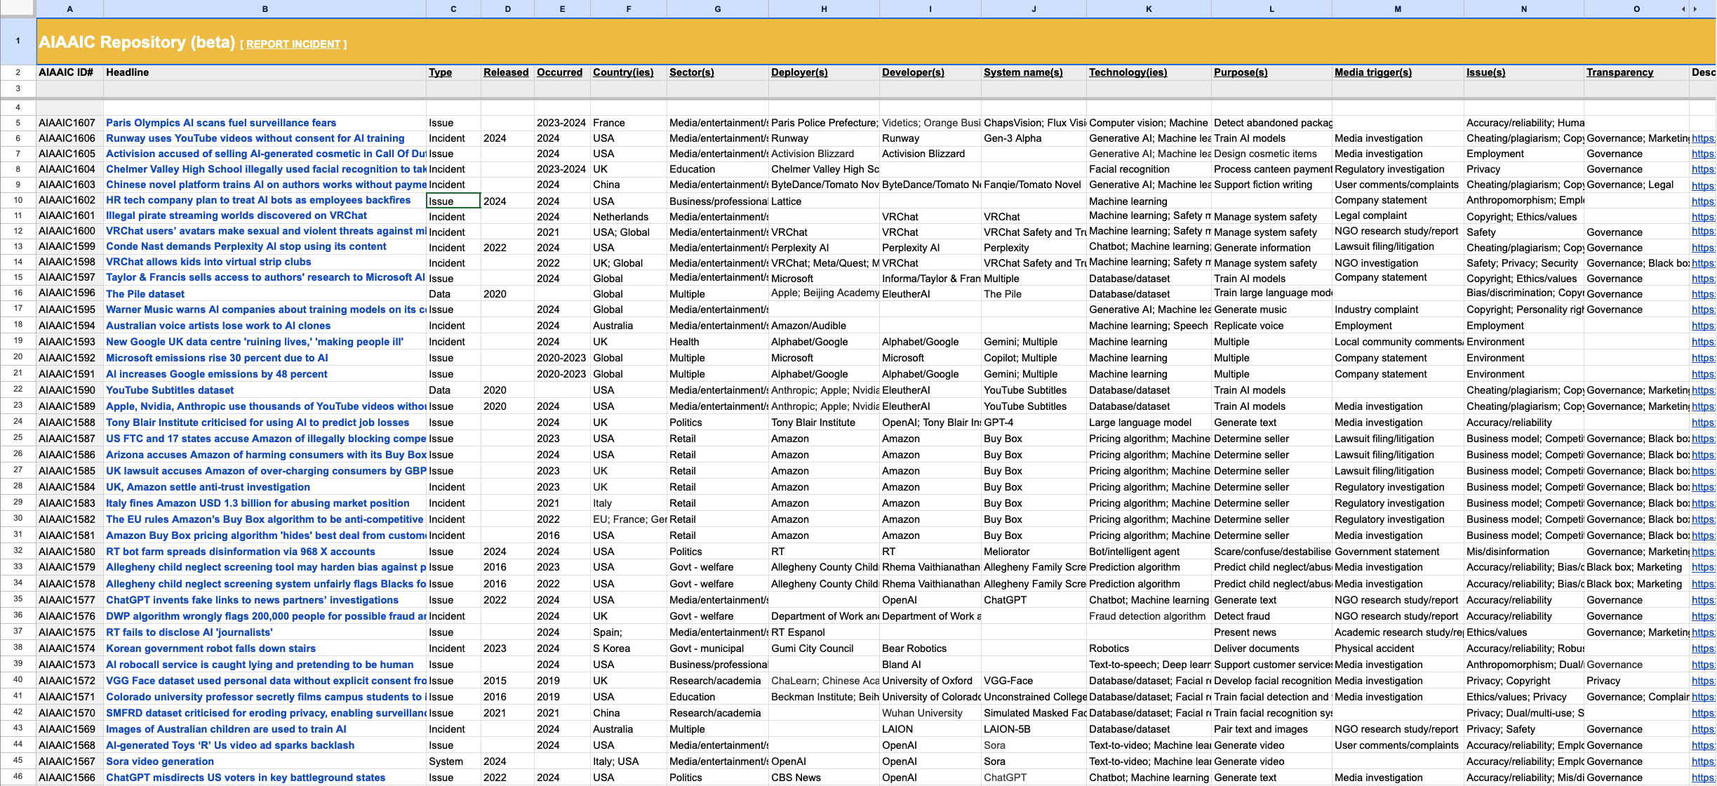
Quote Slide Option 1
AIAAIC is an independent, non-partisan, grassroots public interest initiative that examines and makes the case for real AI, algorithmic, and automation transparency and openness.^{[13]}
^{[13]}https://www.aiaaic.org/

Slide 21
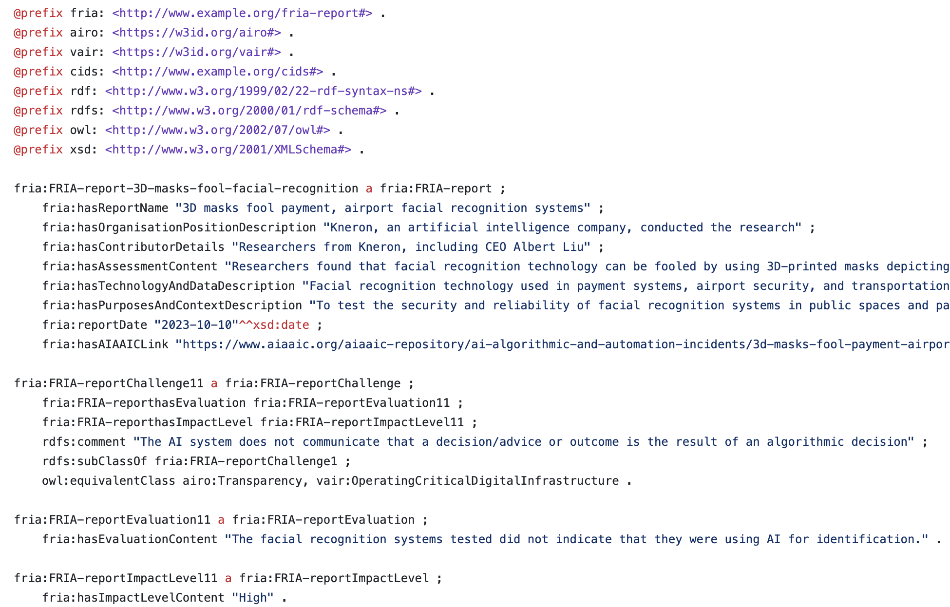
Generated Instances Example
Generated Instances
I’ve generate 50 instances using both the most advanced LLMs right now: Claude 3.5 Sonnet and GPT-4o

Slide 22
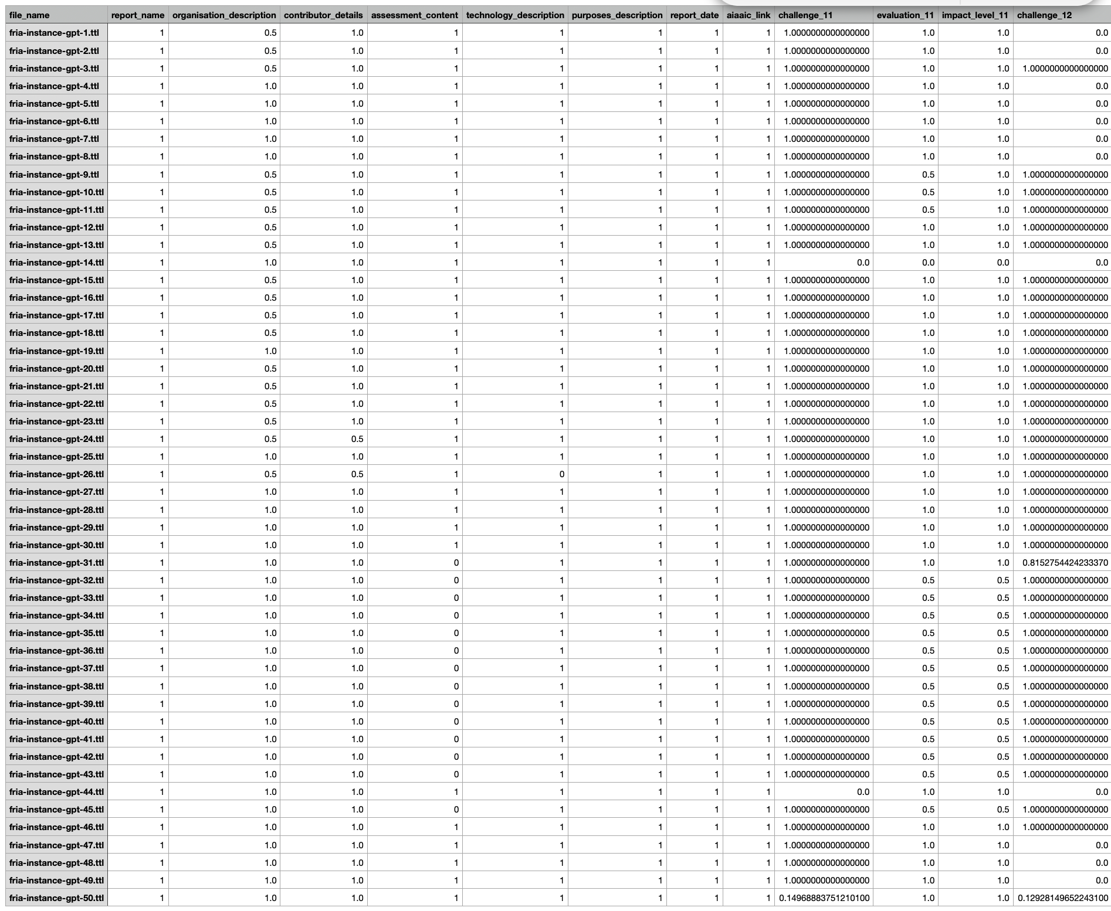
Evaluation

Slide 23
Evaluation
Since this is used for frequency analysis,
if the defined properties exist and are filled by the LLMs, then the value is 1,
If the if the defined properties exist but aren’t filled by the LLMs, then the value is 0.5,
If the defined properties don’t exist, then the value is 0.

Slide 24
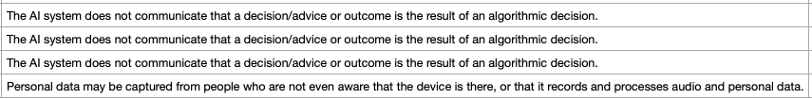
Evaluation
Similarity Scores Calculated for evaluate the challenge in Frequency Analysis
For Challenge, they should look the same since it’s designed in the ontology.
So if it’s different, it means that the LLMs didn’t follow the prompt well and may have wrong understanding of the ontology.
In this example, the challenge is wrong. The Similarity Scores are used to see the correctness of the ontology instance.
Higher the scores, more correct the instance is.

Slide 25
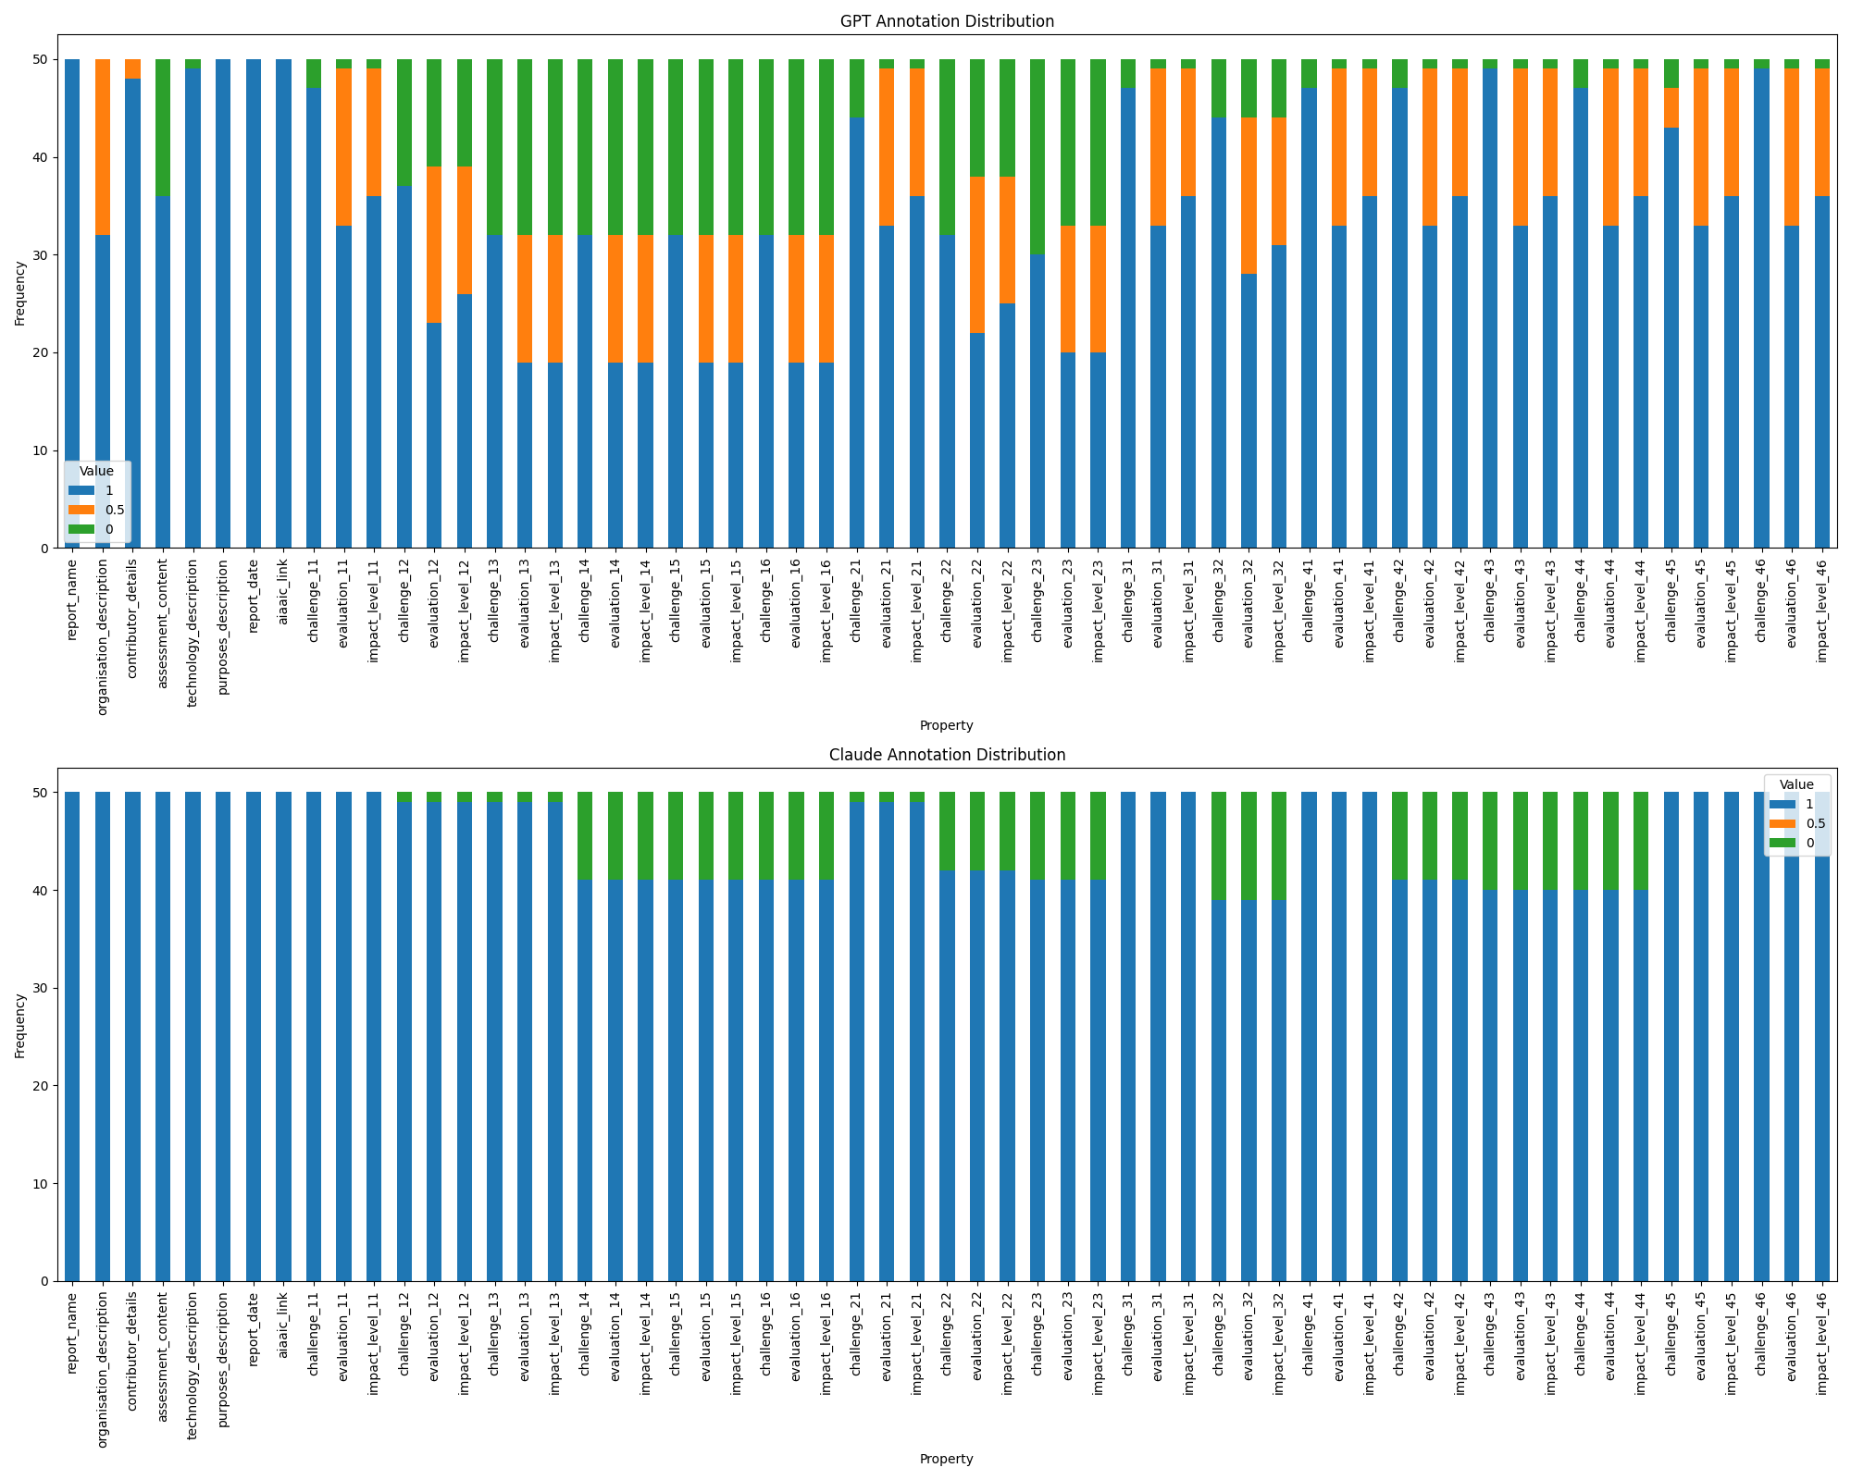
Evaluation
Claude’s performance is better than ChatGPT in this analysis.
Frequency Analysis
Notes:
We can see that GPT miss some poperties, but claude not.

Slide 26
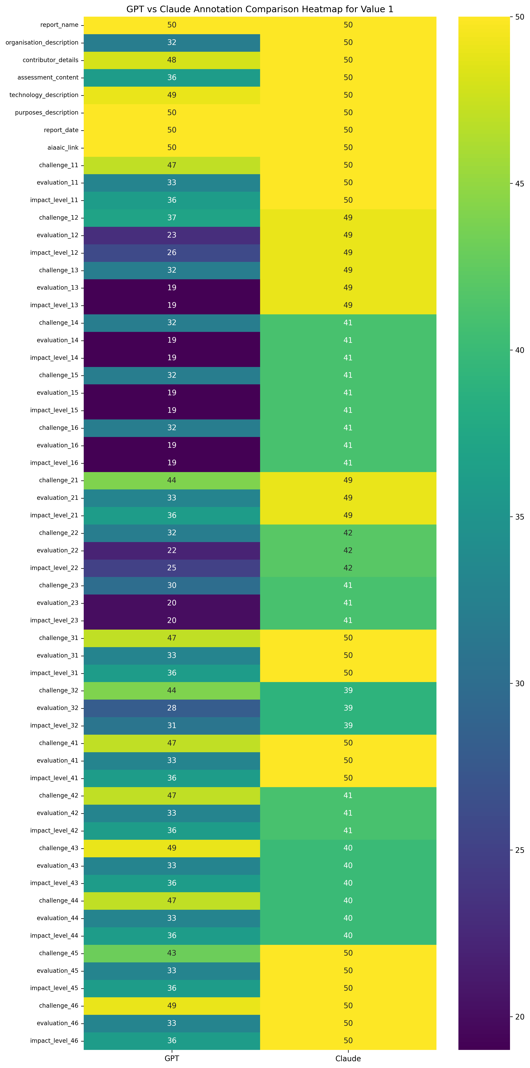
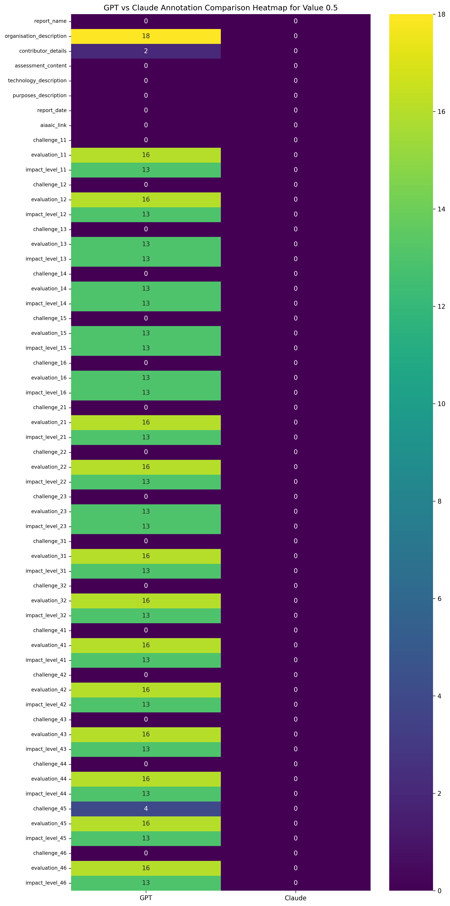
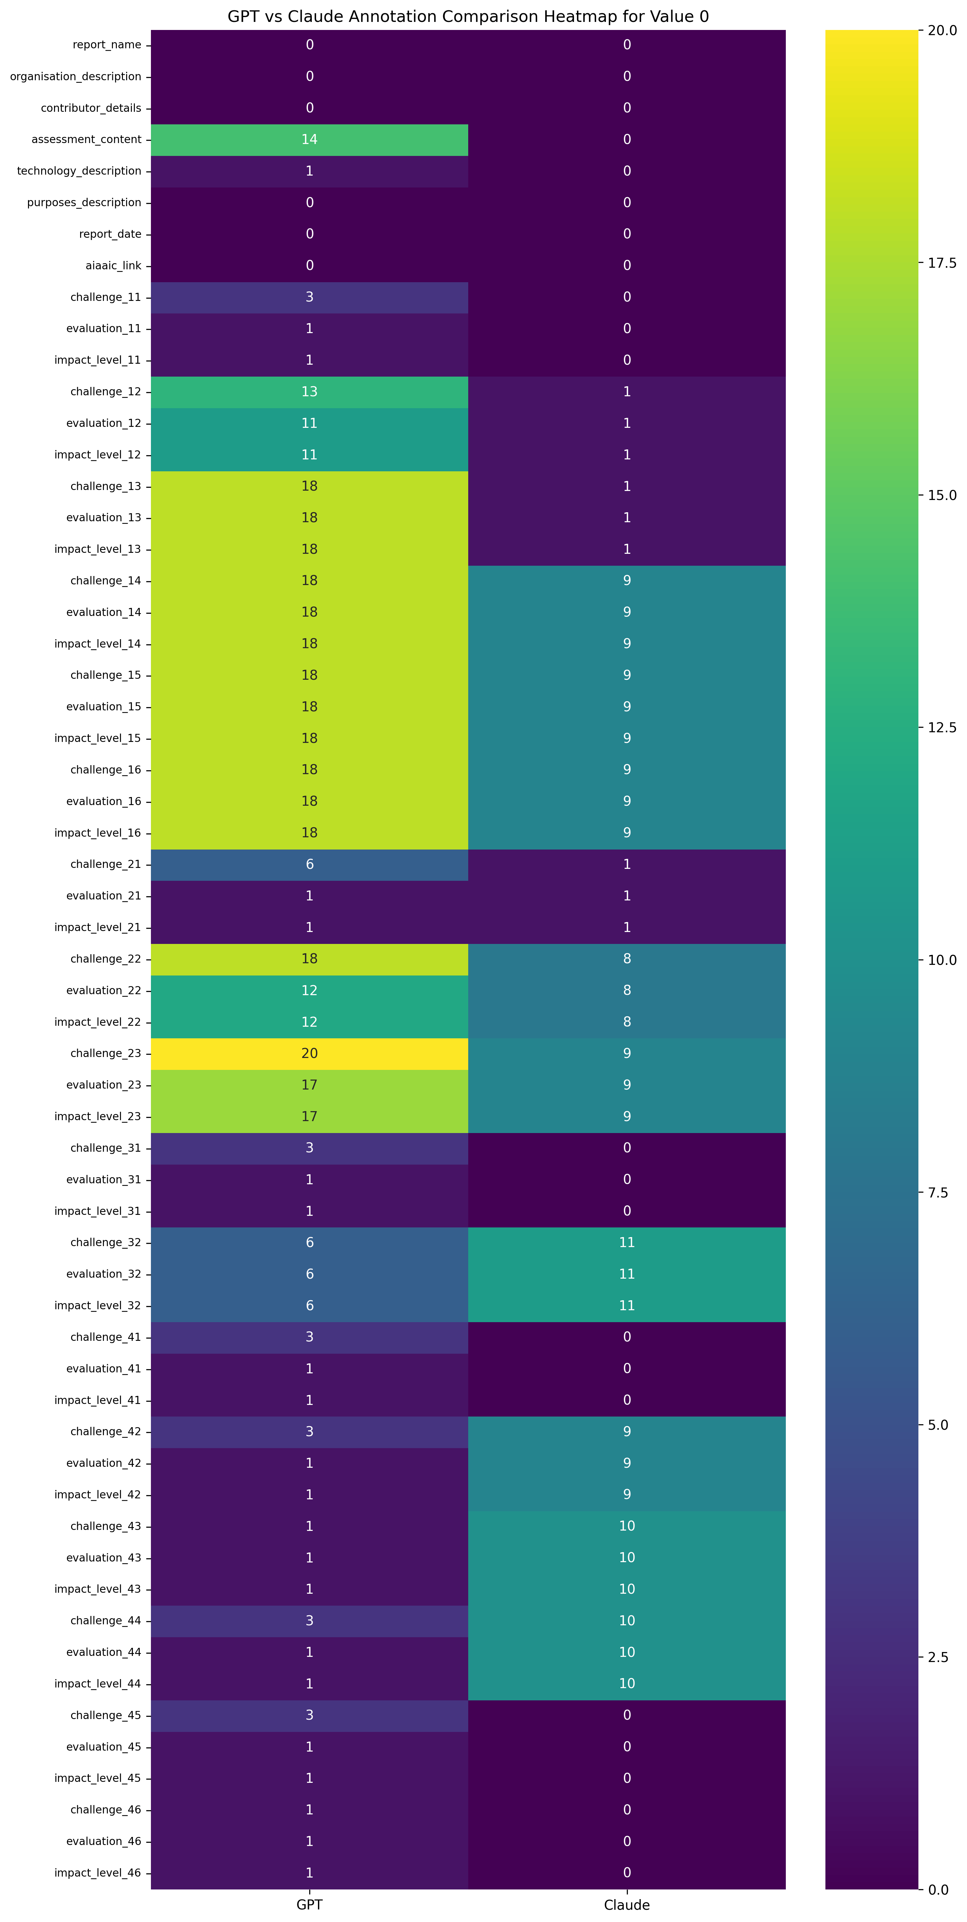
Frequency
Analysis
Claude’s performance is better than ChatGPT in this analysis.
Notes:
This figure show more clearly.

Slide 27
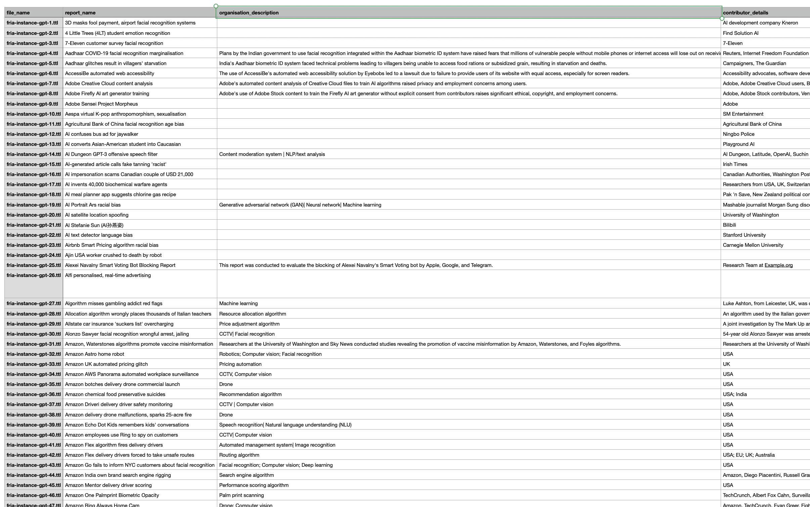
Evaluation
Notes:
All 50 instances are extracted to a csv for analysis.

Slide 28
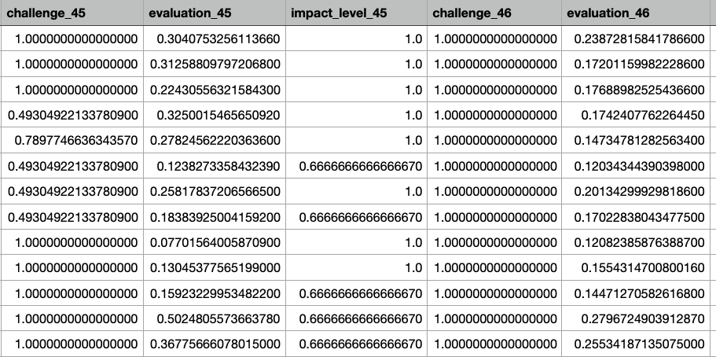
Evaluation
Similarity Scores Calculated for evaluation the different LLMs’ Accuracy of Judgments
For Impact Level, I took the impact level out if it’s existed. (It should be in “low”, “medium”, “high” or "very high")
If there is no available value from any of the LLMs’ output, then it is 0.
If it’s same, then it is 1.
If they are different, it calculates the distance and returns score based on distance.

Slide 29
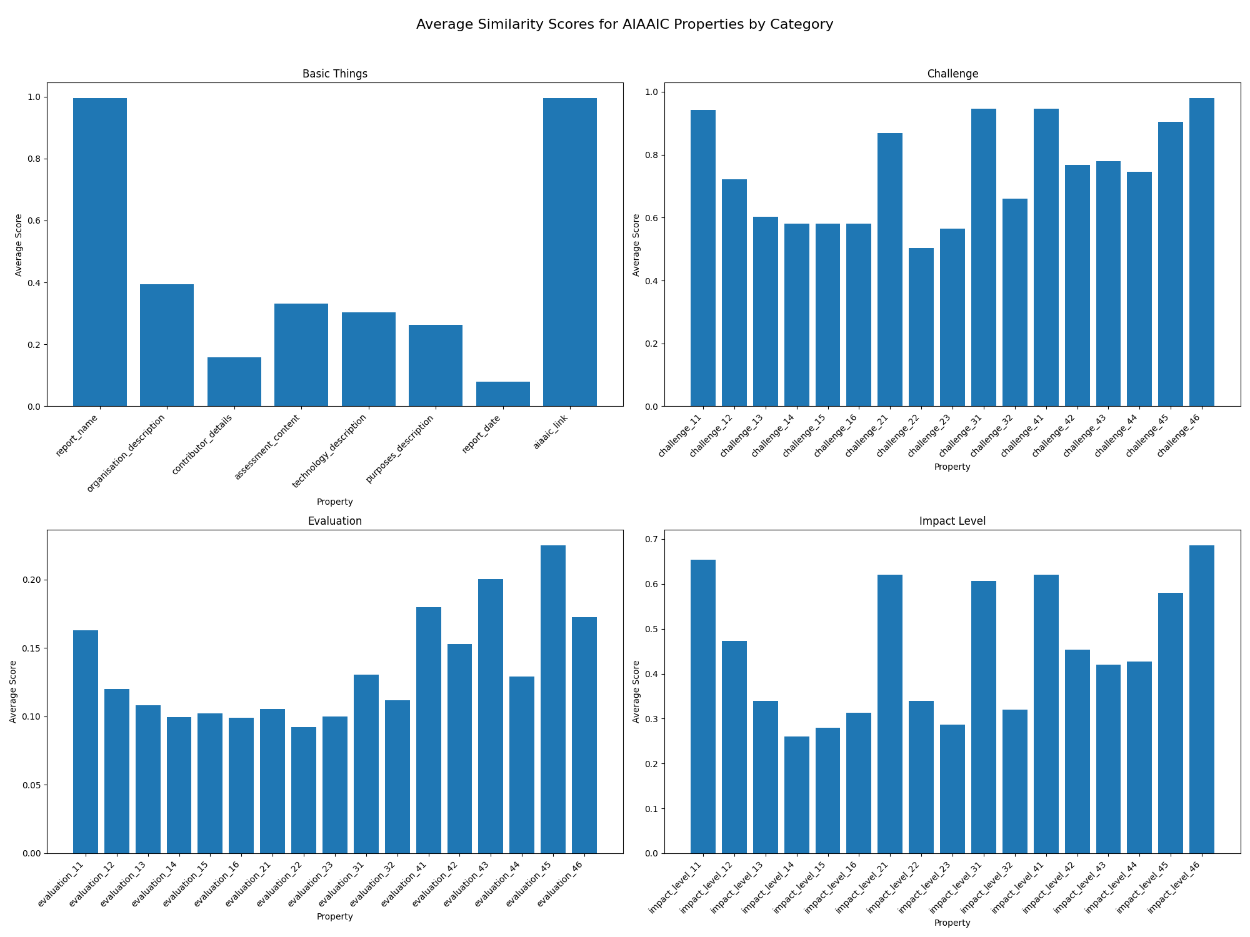
Evaluation
Performance Analysis
The overall similarity of the Impact Level is the best. But for incidents, they have different thoughts.
Notes:
The basic things like report name link is extracted successfully, which means that LLM do well in extract needed information. For other things in basic things, most of them are around 0.35. This may because of that they are summarzed by different LLMs, which may lead to different result and low simlarity scores. For the challenge, we can find that some of them are missing in frequency analysis which may lead to low similarity scores. Which has an overall good result.
Show the nice result from both LLMs.
For the evaluation it’s acceptable since even human can’t have the same evaluation same. But if the impact level is kind of similar, then the result is credible. Which means that the LLM can judge the incidents well in the same context, which means that it’s can be a possible way to use LLMs to do the AI impact assessment. This can be used to face the need of EU AI Act.

Slide 30
Evaluation
Performance Analysis
In Basic Things, LLM extracted all the basic thing successfully. Except the Report Date. This may because they don’t have access to the webpage
Notes:
The basic things like report name link is extracted successfully, which means that LLM do well in extract needed information. For other things in basic things, most of them are around 0.35. This may because of that they are summarized by different LLMs, which may lead to different result and low similarity scores

Slide 31
Evaluation
Performance Analysis
Most of the challenge are extracted successfully. The low similarity scores may because of the low performance of GPT4o. It missed these thing.
Notes:
. For the challenge, we can find that some of them are missing in frequency analysis which may lead to low similarity scores. Which has an overall good result.
Show the nice result from both LLMs.
For the evaluation it’s acceptable since even human can’t have the same evaluation same. But if the impact level is kind of similar, then the result is credible. Which means that the LLM can judge the incidents well in the same context, which means that it’s can be a possible way to use LLMs to do the AI impact assessment. This can be used to face the need of EU AI Act.

Slide 32
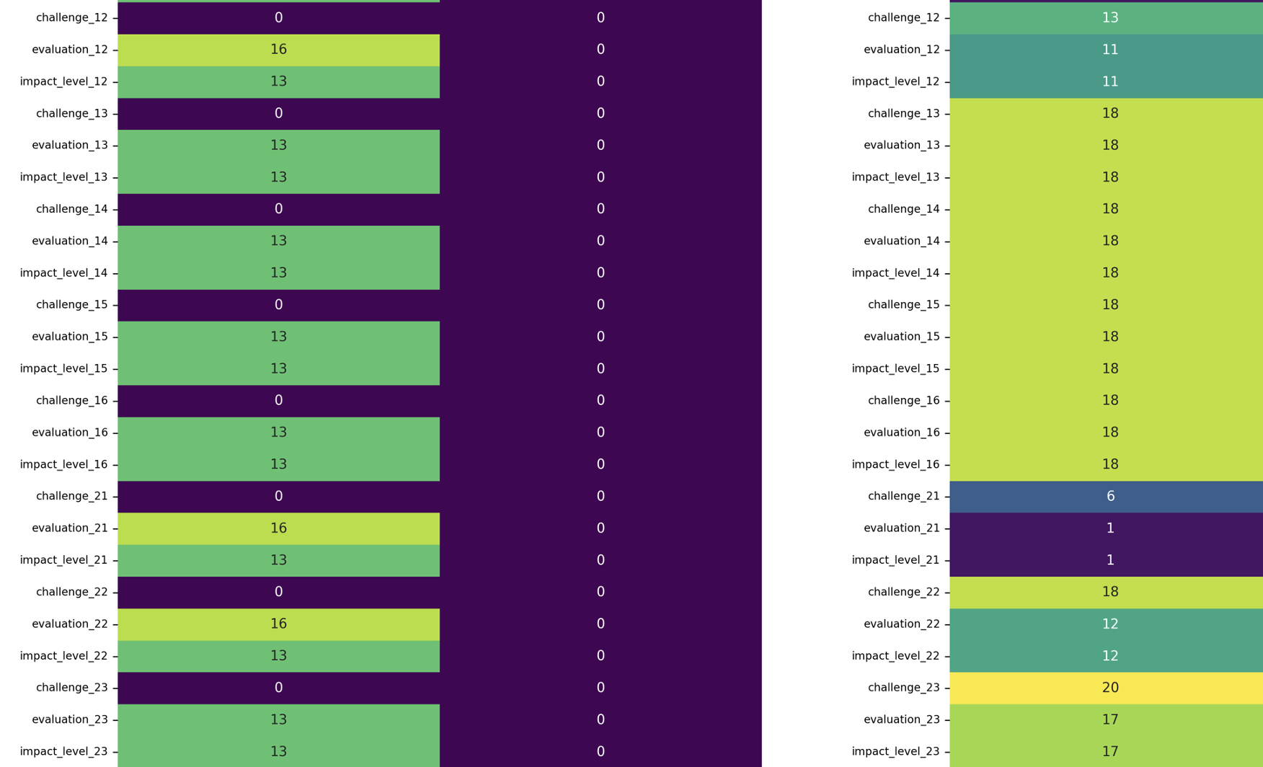
Evaluation
Performance Analysis
Most of the challenge are extracted successfully. The low similarity scores may because of the low performance of GPT4o. The low performance of GPT4o may be result of the low impact level in some challenges’ impact level. The instances from GPT don’t have the specific impact levels like 13.
32
Notes:
. For the challenge, we can find that some of them are missing in frequency analysis which may lead to low similarity scores. Which has an overall good result.
Show the nice result from both LLMs.
For the evaluation it’s acceptable since even human can’t have the same evaluation same. But if the impact level is kind of similar, then the result is credible. Which means that the LLM can judge the incidents well in the same context, which means that it’s can be a possible way to use LLMs to do the AI impact assessment. This can be used to face the need of EU AI Act.

Slide 33
Evaluation
Performance Analysis
For the evaluation, the scores are low and this is expected.
Notes:
For the evaluation it’s acceptable since even human can’t have the same evaluation same.

Slide 34
Evaluation
Performance Analysis
The overall similarity of the Impact Level is the best. Which means that in these context, different LLMs can still have similar result.
This make usage of LLMs in AI Impact Assessment Domain and to face EU AI Act possible.
Notes:
But if the impact level is kind of similar, then the result is credible. Which means that the LLM can judge the incidents well in the same context, which means that it’s can be a possible way to use LLMs to do the AI impact assessment. This can be used to face the need of EU AI Act.

Slide 35
Evaluation
Performance Analysis
The low performance of GPT4o may be result of the low impact level in some challenges’ impact level. The instances from GPT don’t have the specific impact levels like 13.
Notes:
The basic things like report name link is extracted successfully, which means that LLM do well in extract needed information. For other things in basic things, most of them are around 0.35. This may because of that they are summarzed by different LLMs, which may lead to different result and low simlarity scores. For the challenge, we can find that some of them are missing in frequency analysis which may lead to low similarity scores. Which has an overall good result.
Show the nice result from both LLMs.
For the evaluation it’s acceptable since even human can’t have the same evaluation same. But if the impact level is kind of similar, then the result is credible.
Most of the impact level have a similar result. For the low result, this may because the blank evaluation of GPT. Which means that the LLM can judge the incidents well in the same context, which means that it’s can be a possible way to use LLMs to do the AI impact assessment. This can be used to face the need of EU AI Act.

Slide 36
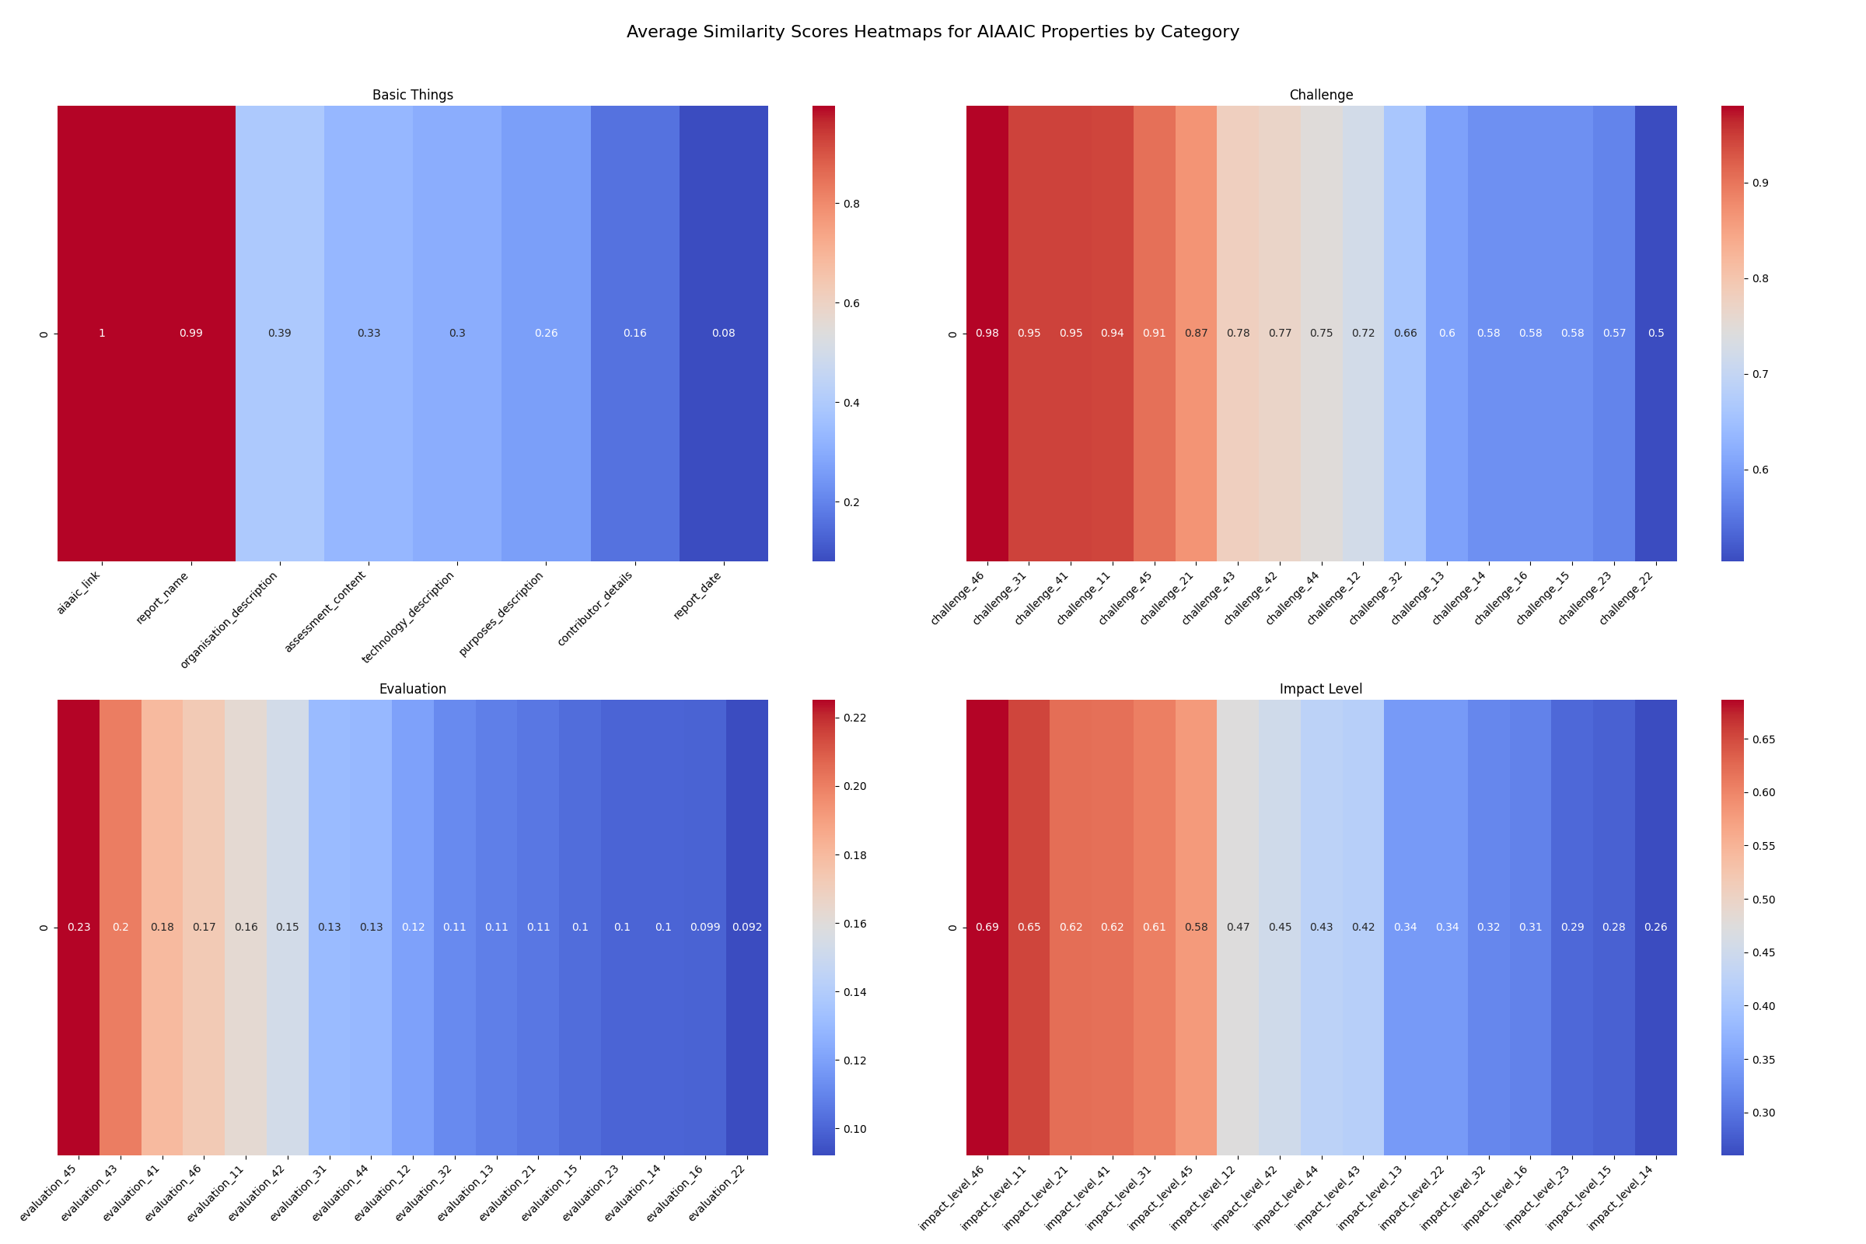
Evaluation
Performance Analysis
The overall similarity of the Impact Level is the best.

Slide 37
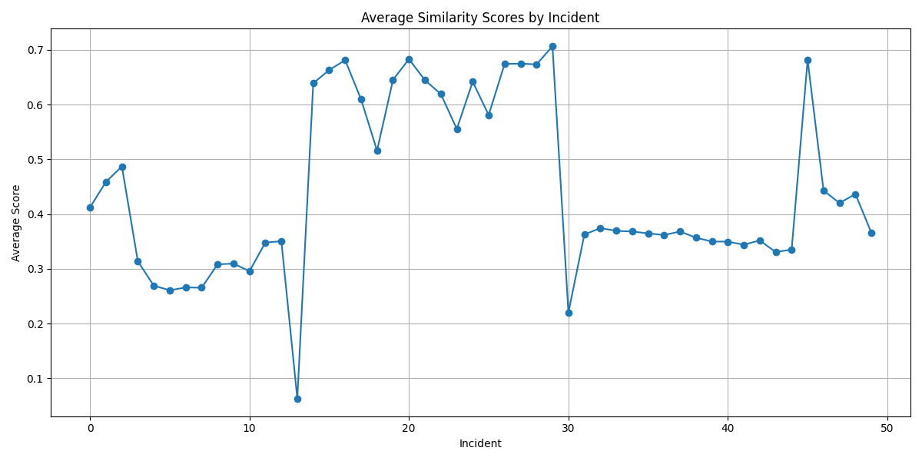
Evaluation
Performance Analysis
We can see that some incident have very high scores. In these case, the LLM is not lazy.
Notes:
For the low case situation, some reason may because of lazy LLM. To improve this, maybe we can update the prompt.

Slide 38
Quote Slide Option 1
Research Questions
How can we integrate Fundamental Rights Impact Assessment (FRIA) into existing ontological frameworks such as AI Risk Ontology (AIRO), Vocabulary of AI Risks (VAIR), and Common Impact Data Standard (CIDS) to create a more comprehensive ontological structure for impact assessment?
To what extent can Large Language Models (LLMs) be effectively utilized to populate Fundamental Rights Impact Assessment (FRIA) reports and related ontologies, thereby assisting in the completion of AI impact assessments?
Notes:
My research has successfully addressed both research questions.I’ve integrated FRIA into existing ontological frameworks like AIRO, VAIR, and CIDS, creating a comprehensive structure for impact assessment.I’ve also demonstrated that well-tuned Large Language Models can effectively populate these integrated FRIA reports and ontologies. This innovative approach offers a new, efficient method for conducting AI impact assessments, aligning with EU AI Act requirements and streamlining regulatory compliance.

Slide 39
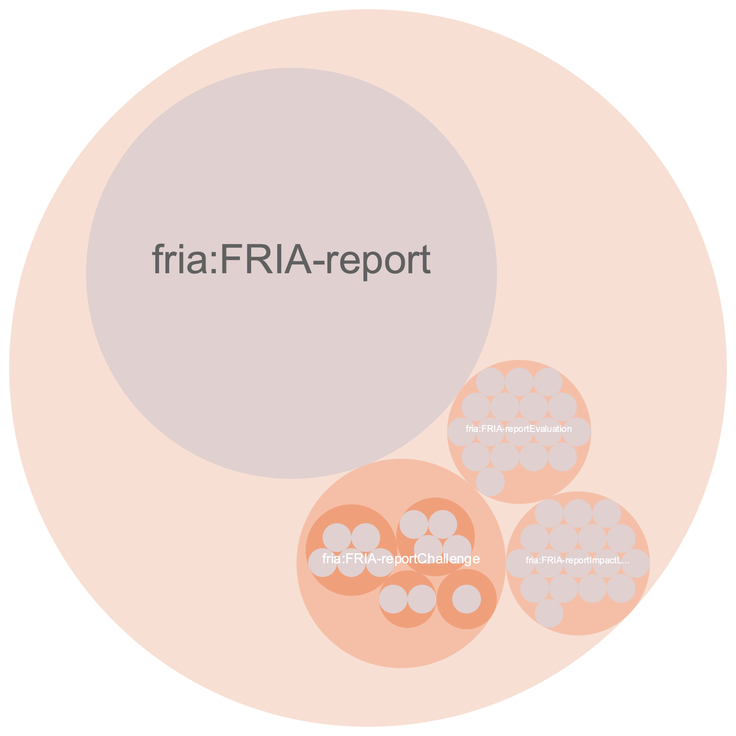
GraphDB Visualizations
Class Hierarchy

Slide 40
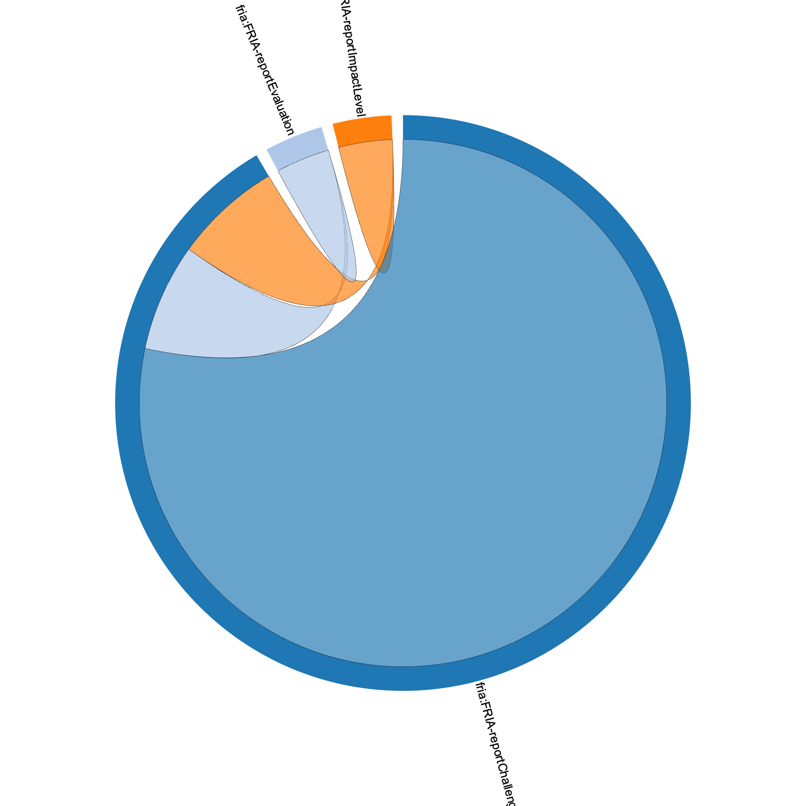
GraphDB Visualizations
Dependencies

Slide 41
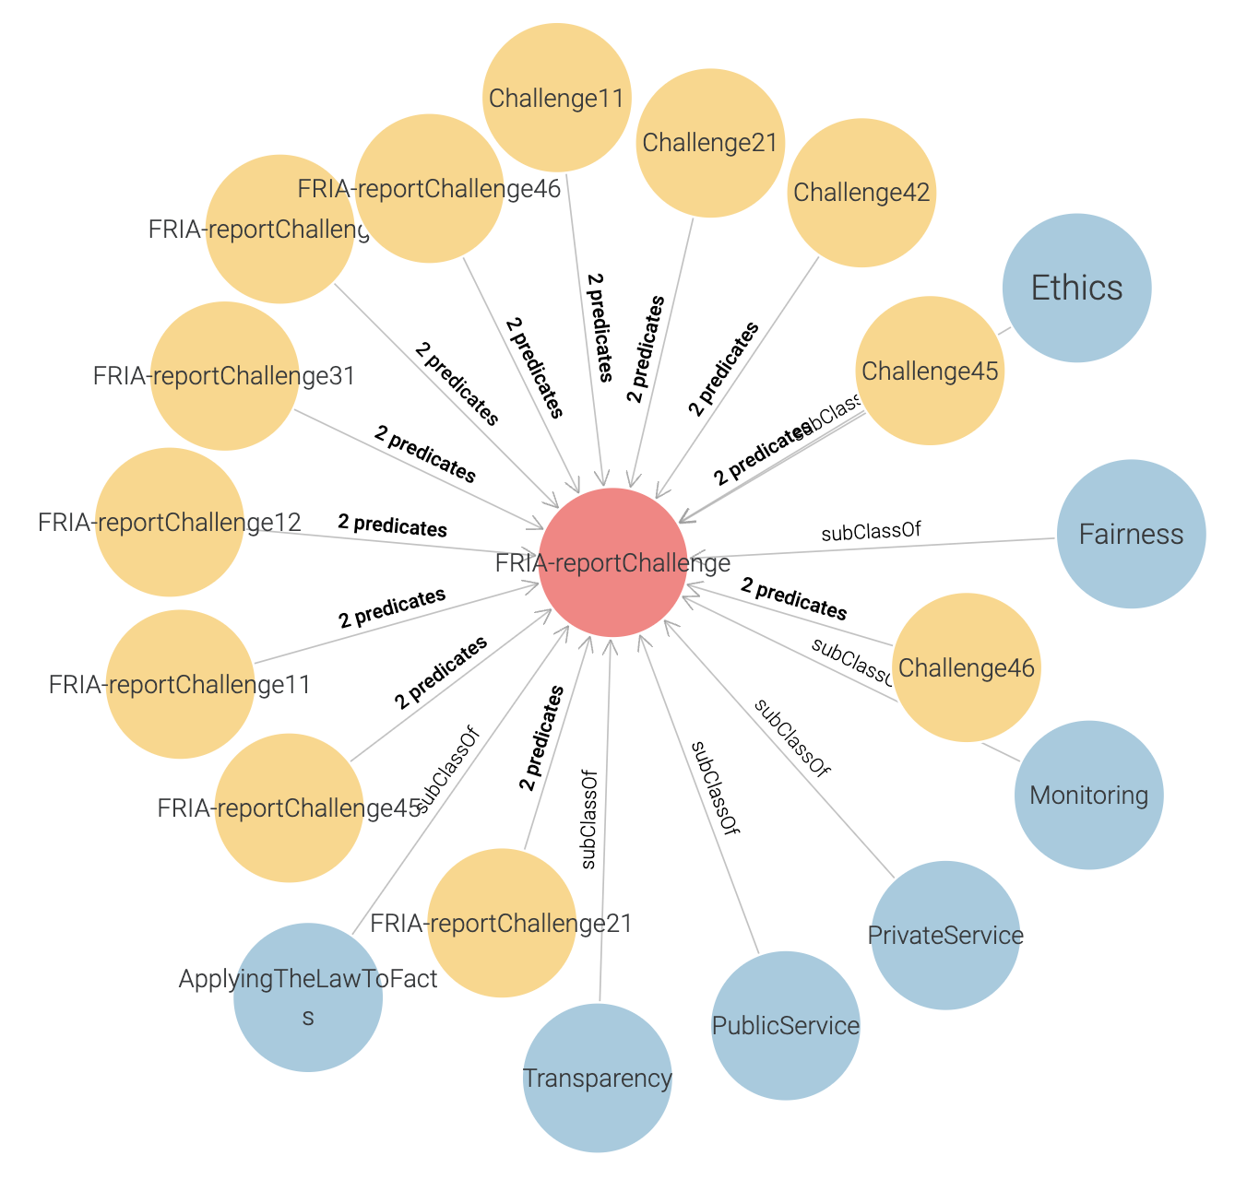
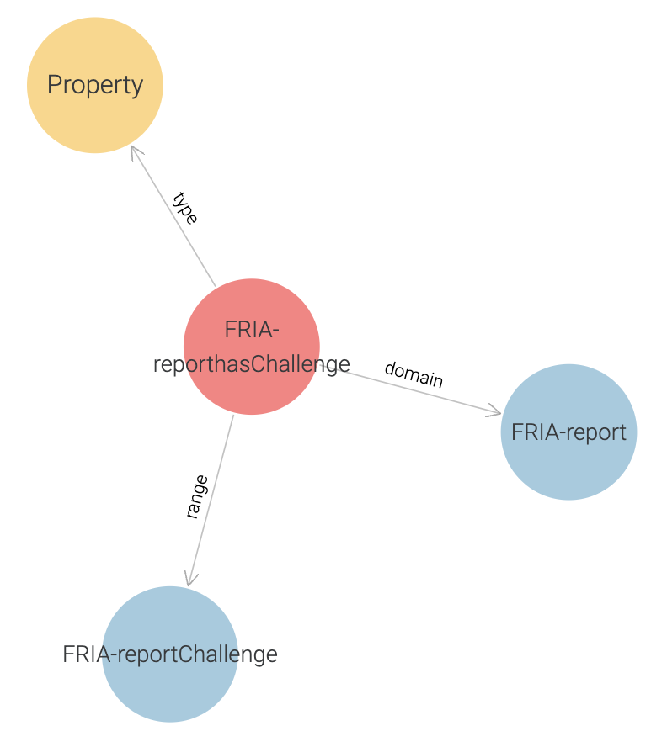
GraphDB Visualizations

Slide 42
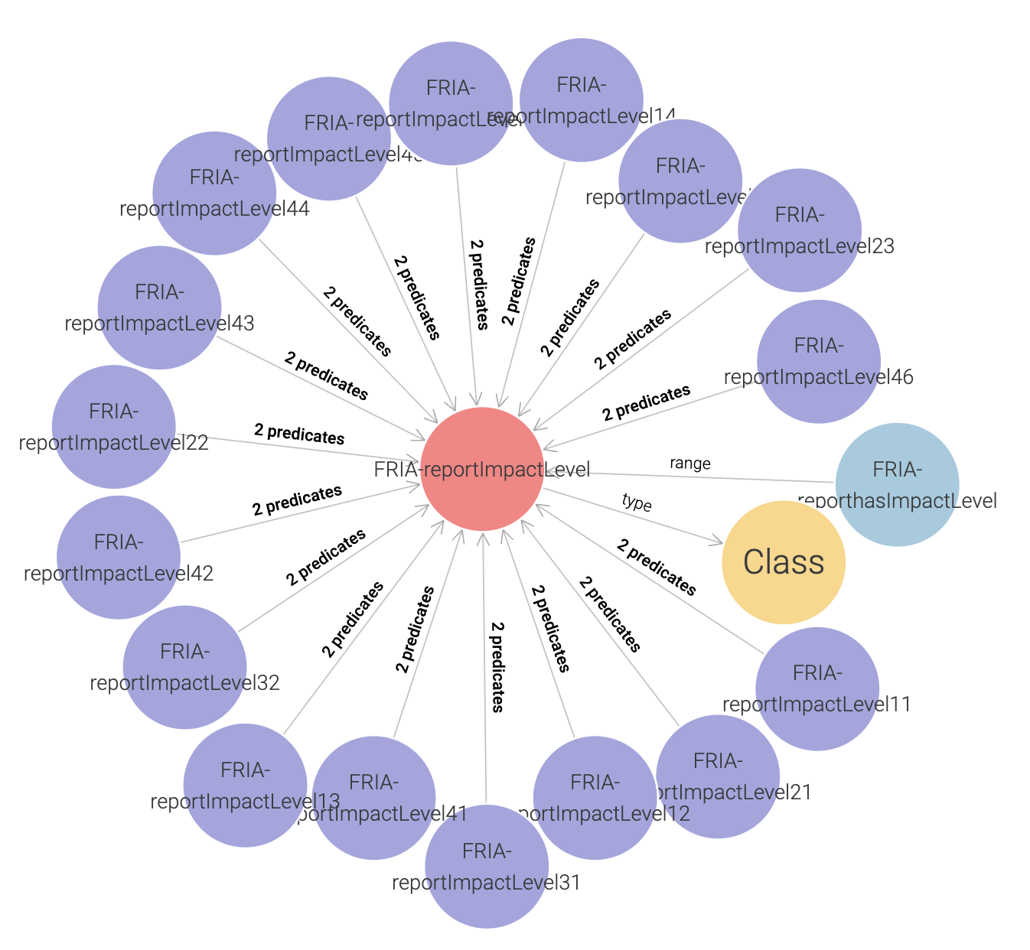
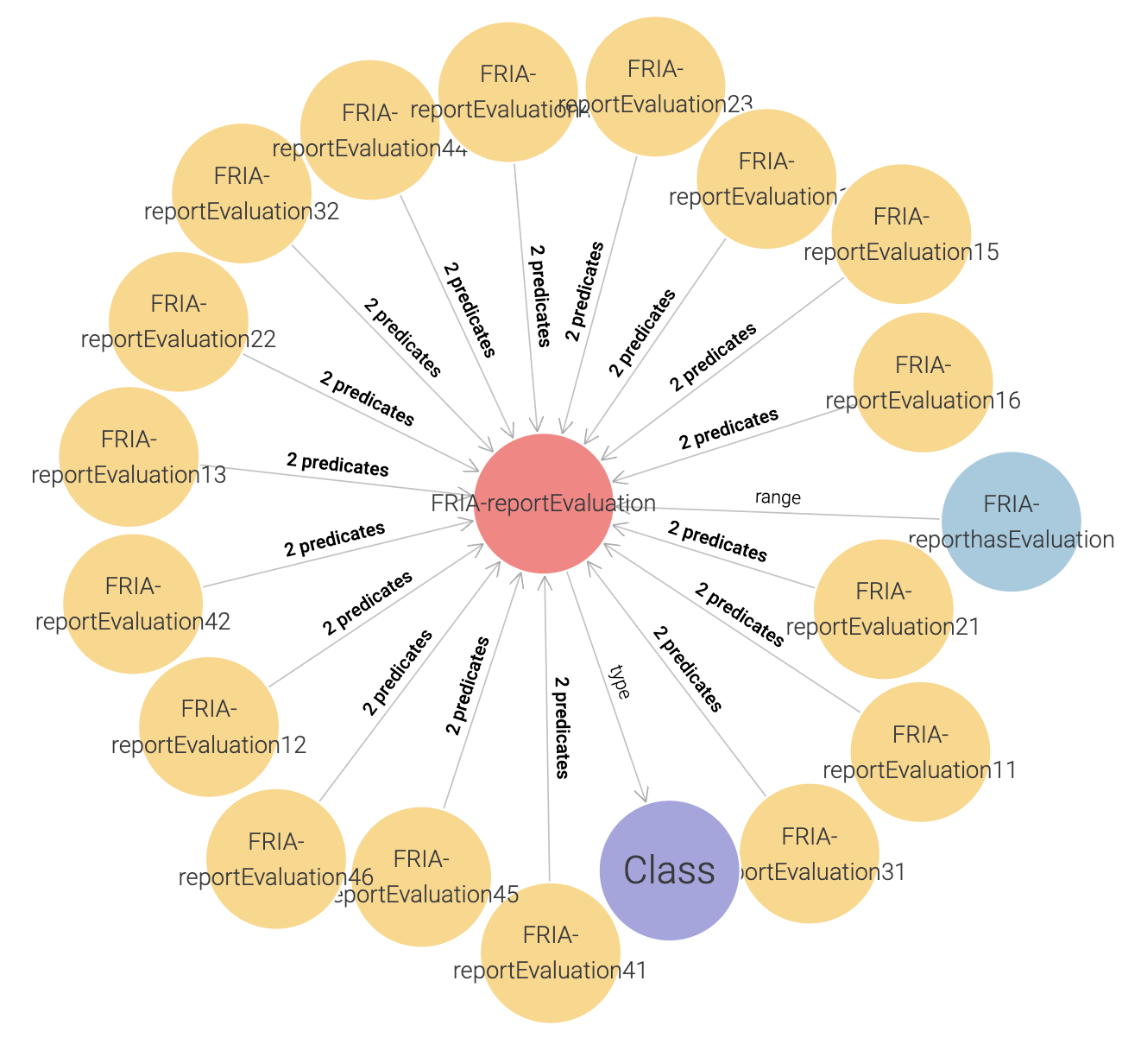
GraphDB Visualizations

Slide 43
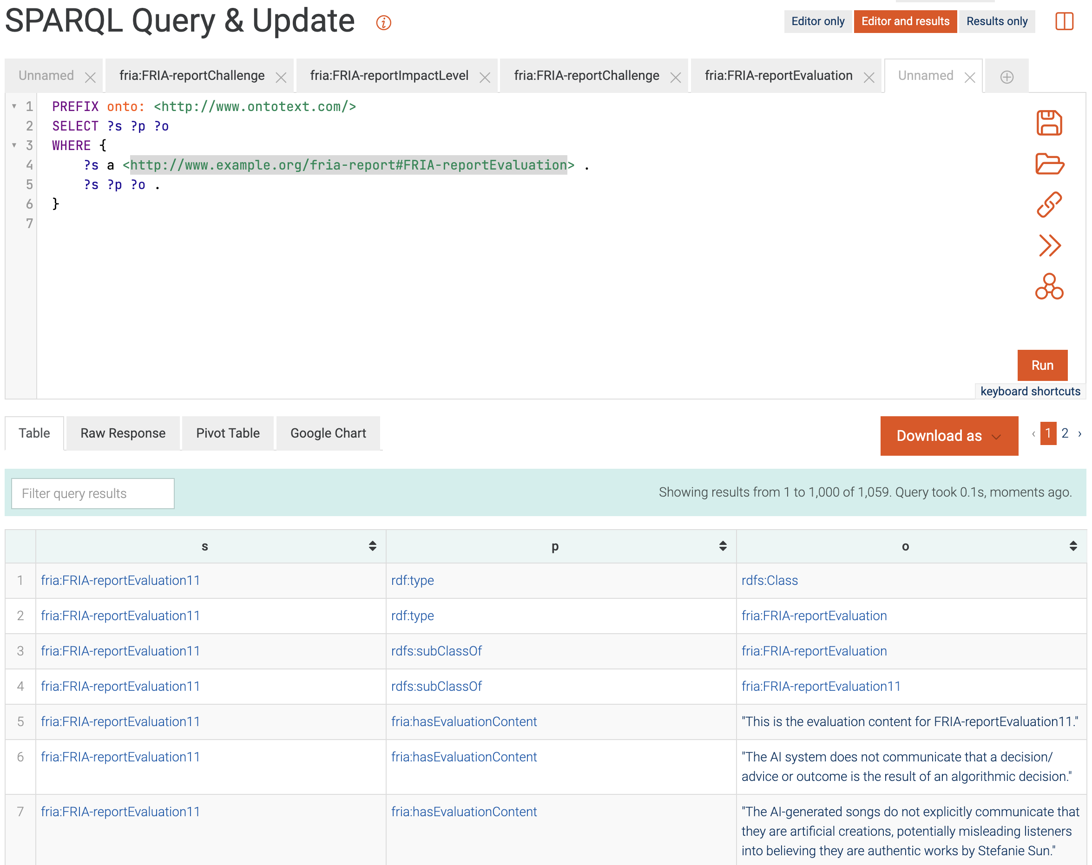
GraphDB SPARQL

Slide 44
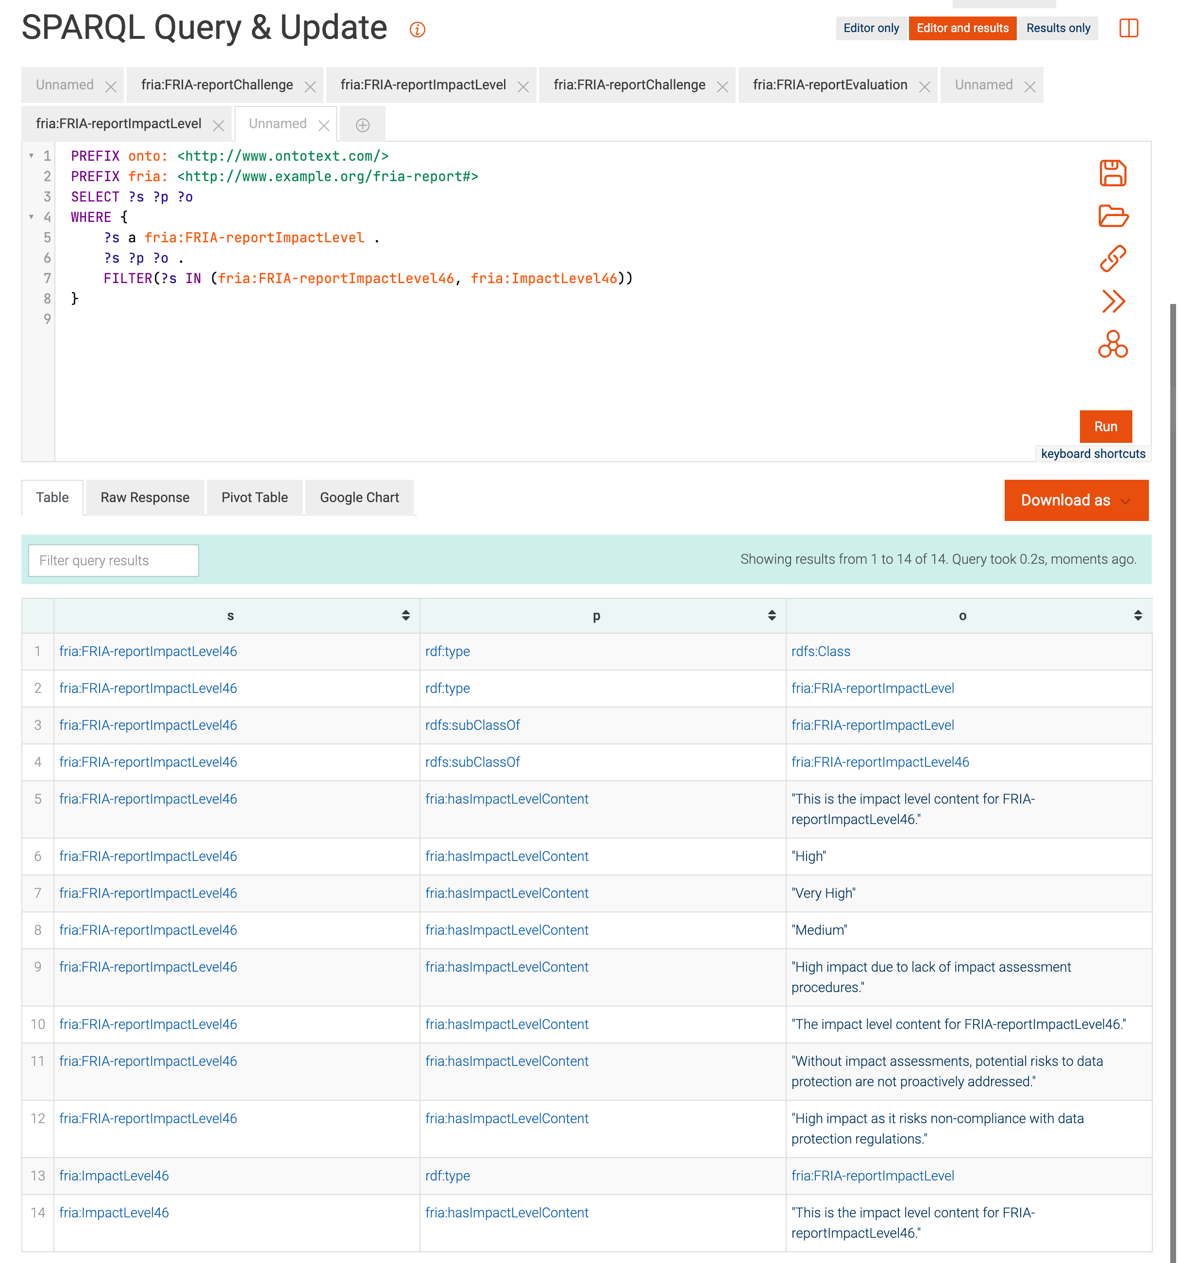
GraphDB SPARQL

Slide 45
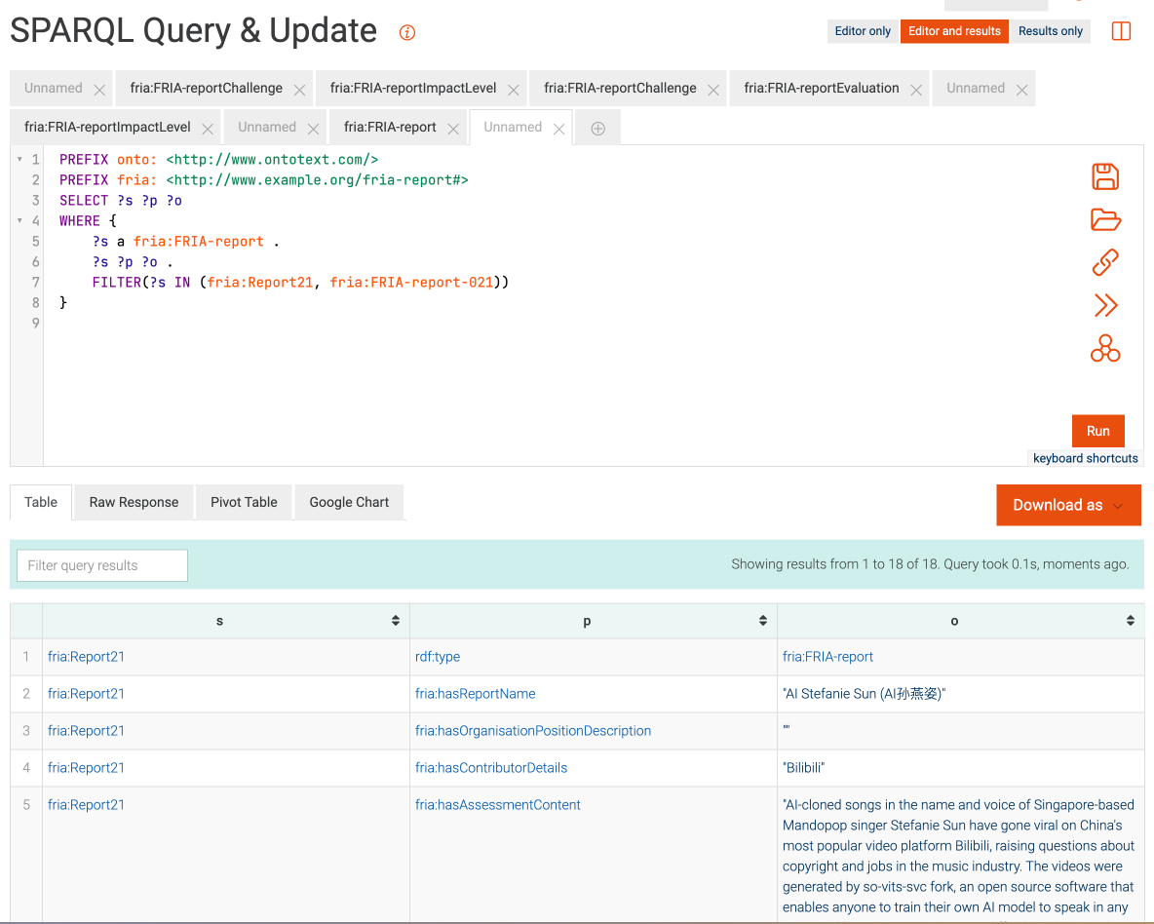
GraphDB SPARQL

Slide 46
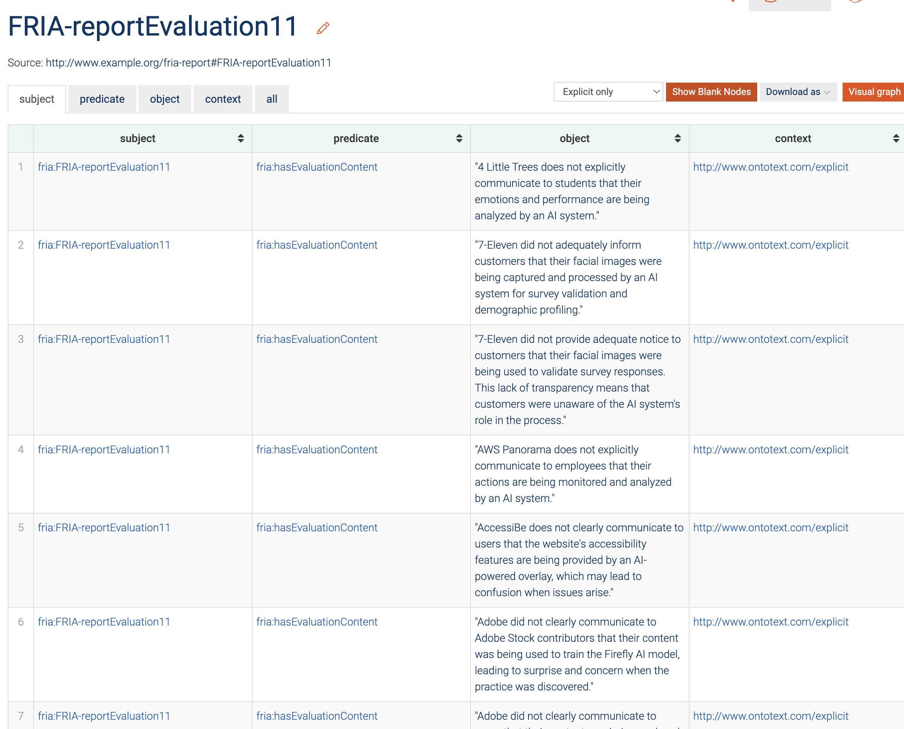
GraphDB SPARQL

Slide 47
Conclusion
Successfully find a possible way to face the need of EU AI Act.
Developed the FRIA ontology based on the FRIA report template.
Established the relationship with FIRA and CIDS, AIRO, VAIR.
Explored a new way to do the Impact Assessment by using the prompt engineering with the latest LLMs.
Discovered a way to evaluate the performance of different LLMs when facing the same context.
Claude 3.5 Sonnet has better performance than the ChatGPT 4o.
Successfully answer both the Research Question 1 and 2.
Trinity College Dublin, The University of Dublin

Slide 48
Future Works
Develop more relationships than now.
Update the prompt to prevent the “lazy LLM”.
Have some general way to automatically grab the data and update the ontology instances in server.
Make everyone can see the result from internet.
Make the evaluation and impact level more accurate.
Trinity College Dublin, The University of Dublin

Slide 49
Thank You!
Supervisor: Dr. David Lewis Dr. Subrahmanyam Murala
Kaiyu Chen (23330889)
MSc in Computer Science - Intelligent Systems

